Slide 1

Global Motion Compensation
Computer Vision Final Project
R12921122 張嘉仁/ R12921A10 謝宗翰 / R12921068 吳凱濠

Slide 2

Our method
Kmeans
Segmentation
How to find best 12 homography
Brute method to find best homography

Slide 3
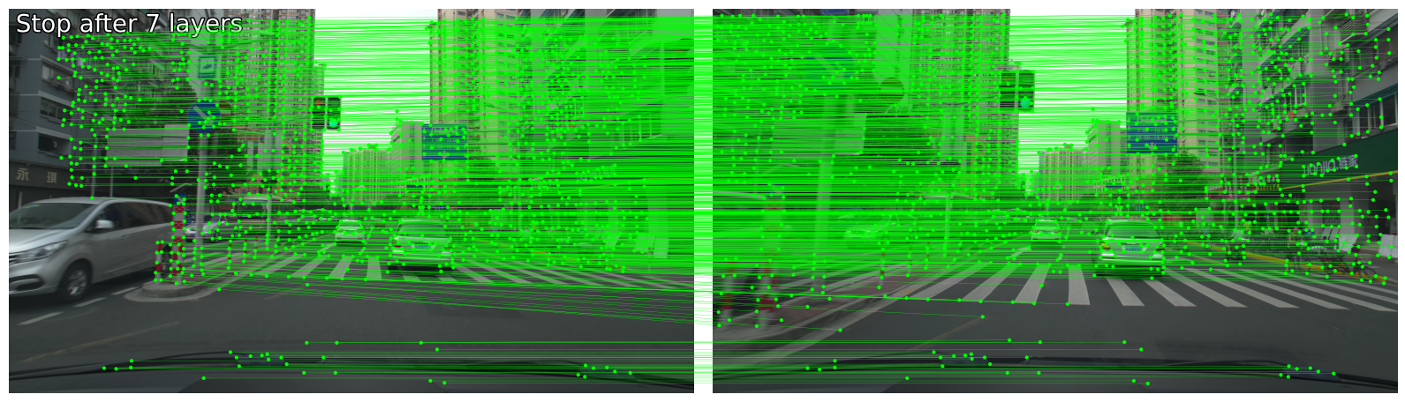
Finding Keypoint
LightGlue:
LightGlue is a deep neural network that matches sparse local features across image pairs.
ICCV 2023

Slide 4
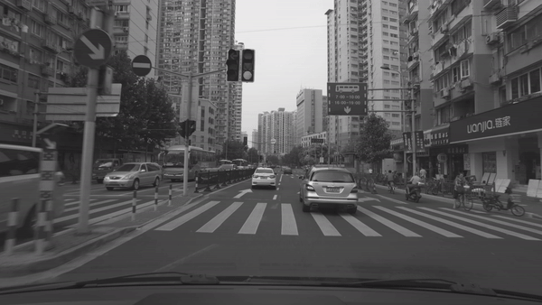
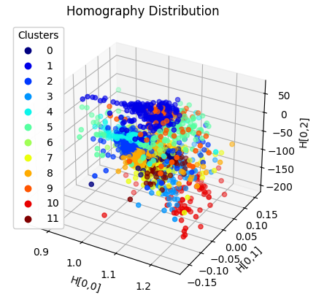
KMeans Method
KMeans:
Using sliding windows of various sizes to scan through reference and target photos, compute the homography matrix for corresponding windows, and then use K-means clustering to identify cluster centroids.
Method | PSNR
KMeans - 6 | 50.38
KMeans - 8 | 50.43
KMeans - 12 | 50.52

Slide 5
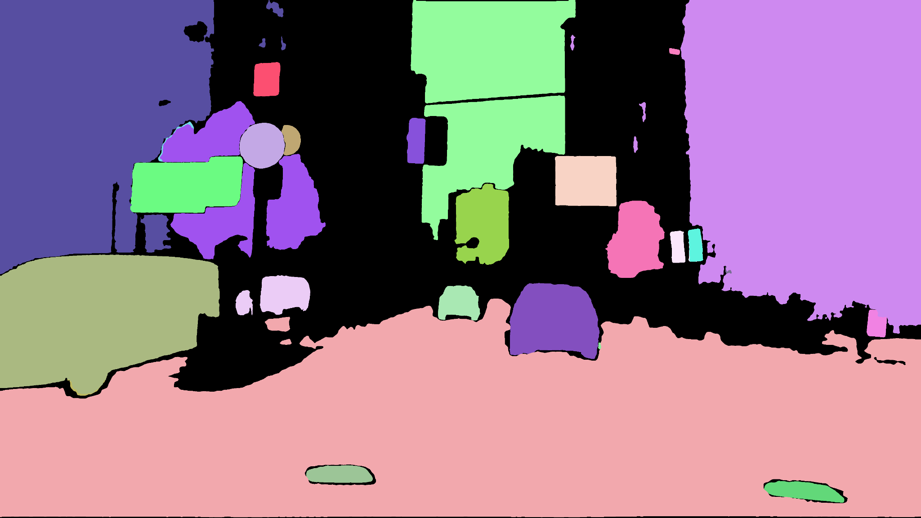
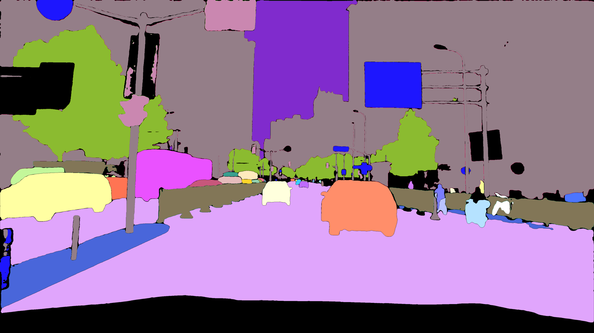
Segmentation Method
Segmentation:
Using Oneformer for segmentation and LightGlue to calculate the homography matrix for corresponding objects.
The quality from segmentation will significantly affect the calculation of PSNR.
SAM Tracking
OneFormer

Slide 6
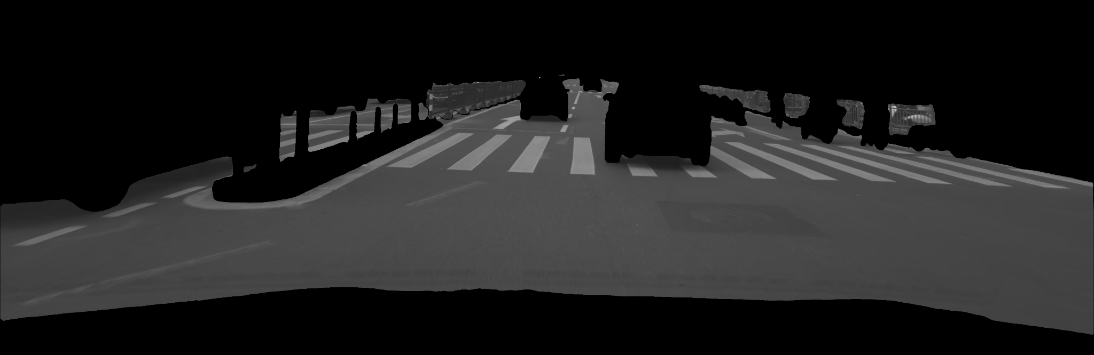
Segmentation Method
Segmentation:
Use homography which applied by KMeans with the segmentation of large objects and then calculate the PSNR.
Method | PSNR | Δ
KMeans6 + seg*4 | 52.84 | +2.32
KMeans8 + seg*2 | 52.7 | +2.18
KMeans12 | 50.52 | +0
Segmentation can effectively improve PSNR !!

Slide 7

Segmentation Method
Segmentation:
Use homography which applied by KMeans with the segmentation of large objects and then calculate the PSNR.
Method | PSNR | Δ
KMeans6 + seg*4 | 52.84 | +2.32
KMeans8 + seg*2 | 52.7 | +2.18
KMeans12 | 50.52 | +0
How to get the best ratio ?

Slide 8
Find best 12 homography
Greedy Algorithm:
In each round, select one homography matrix to add to the model. The selection criterion is the homography matrix that decreases MSE the most. A total of 12 rounds will be conducted
Segmentation + KMeans Homography pool
H1 | H2 | … | H59 | H60
Method | PSNR
KMeans30 + seg*30 (only using ref0) | 54.31
Find 12 best model (Homography) Depending on the extent of MSE reduction

Slide 9
Add Inverse Matrix
Inverse ref0 H to imitate ref1 H:
Add the inverse homography matrix from reference 0 to target to the homography matrix from reference 1 to target, and vice versa.
The searching time will be double
Method | PSNR | Δ
KMeans30 + seg*30 (only using ref0) | 54.31 | X
KMeans30 + seg*30 (with ref0 inverse) | 54.52 | +0.21
Method | PSNR | Δ
All seg | 54.40 | X
Only ref0 seg with inv | 54.53 | +0.13
(Effect of inv)
(Comparison of ref0 and inv)

Slide 10
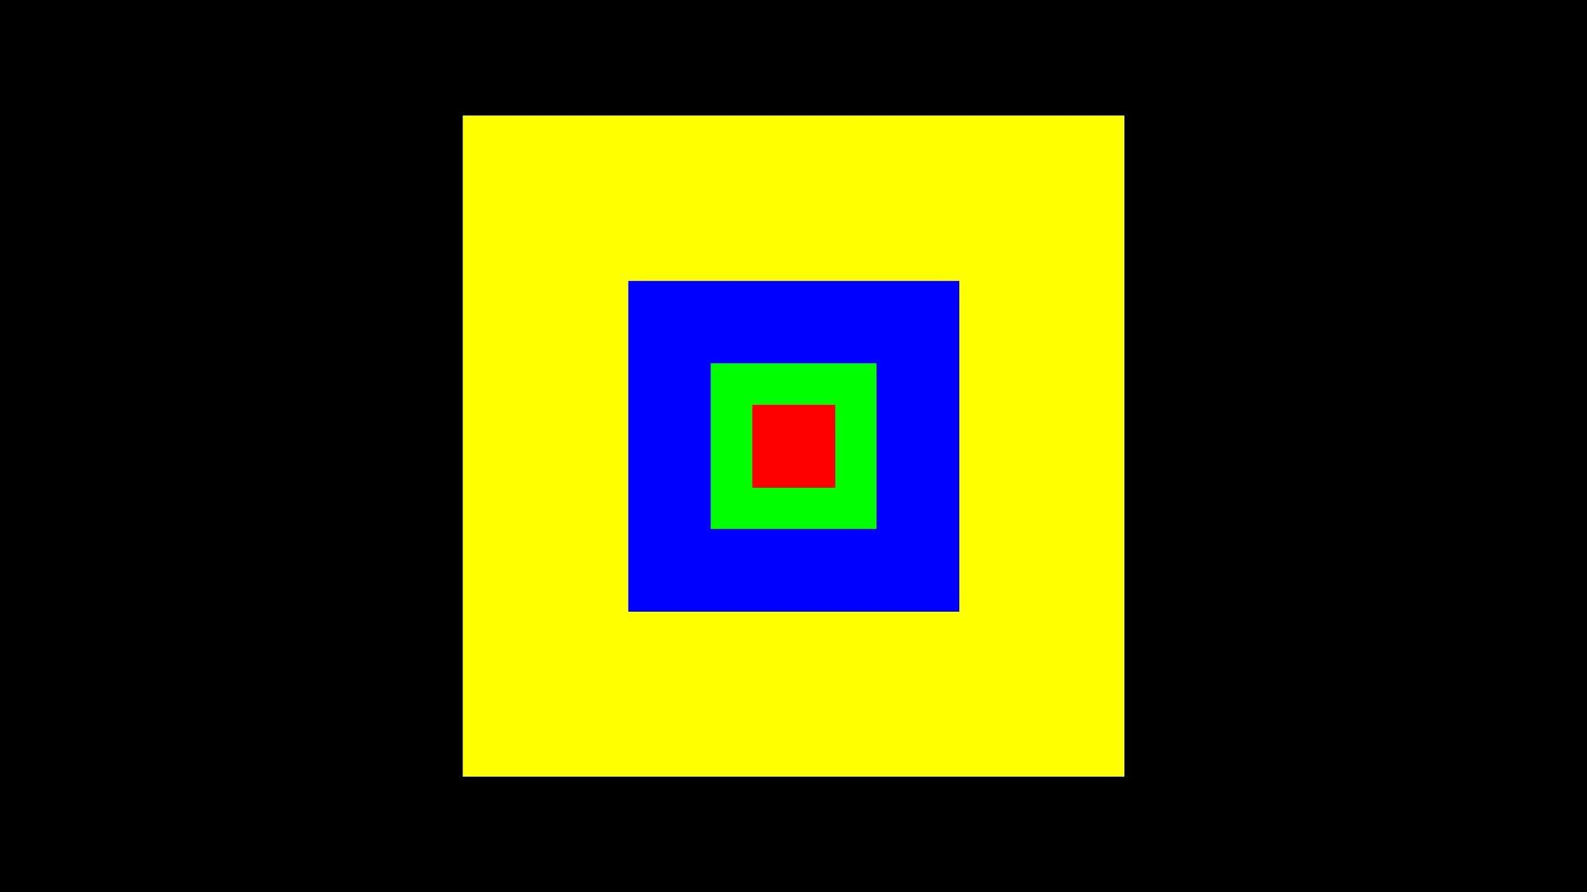
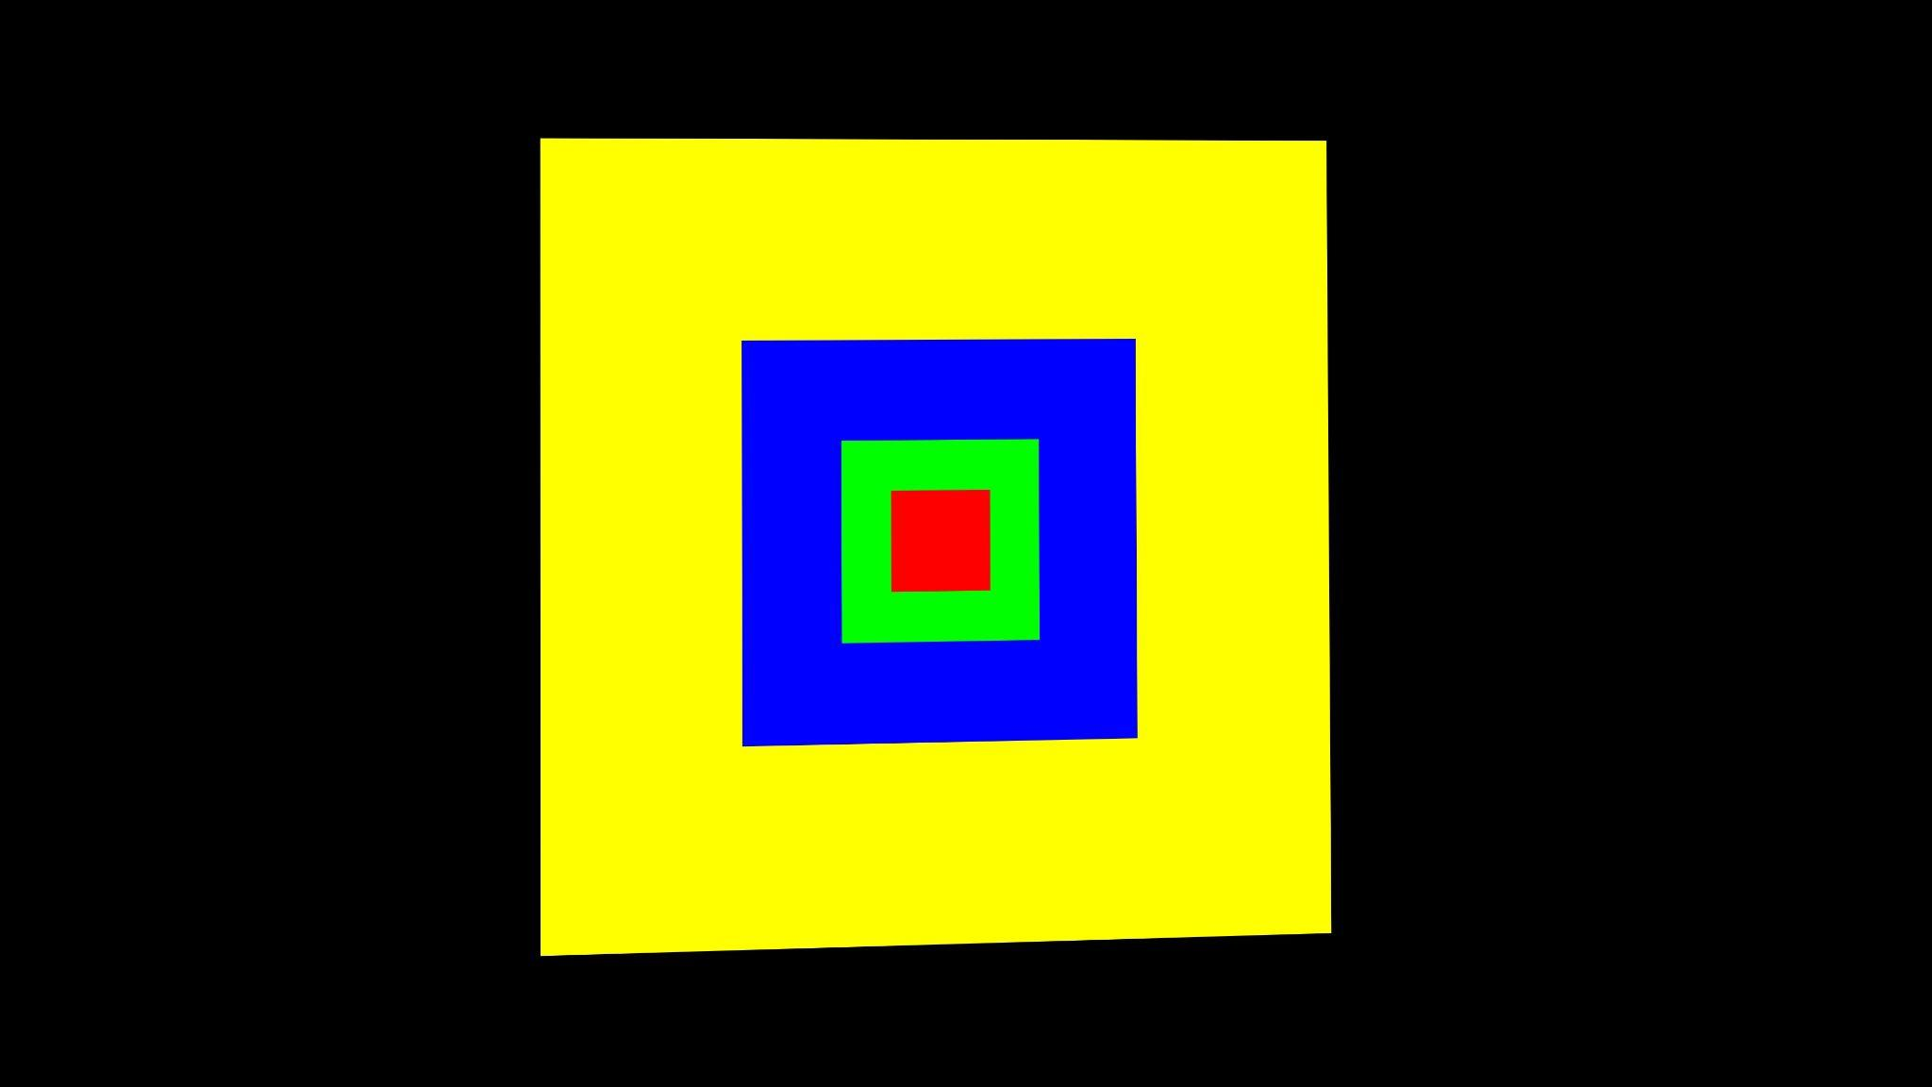
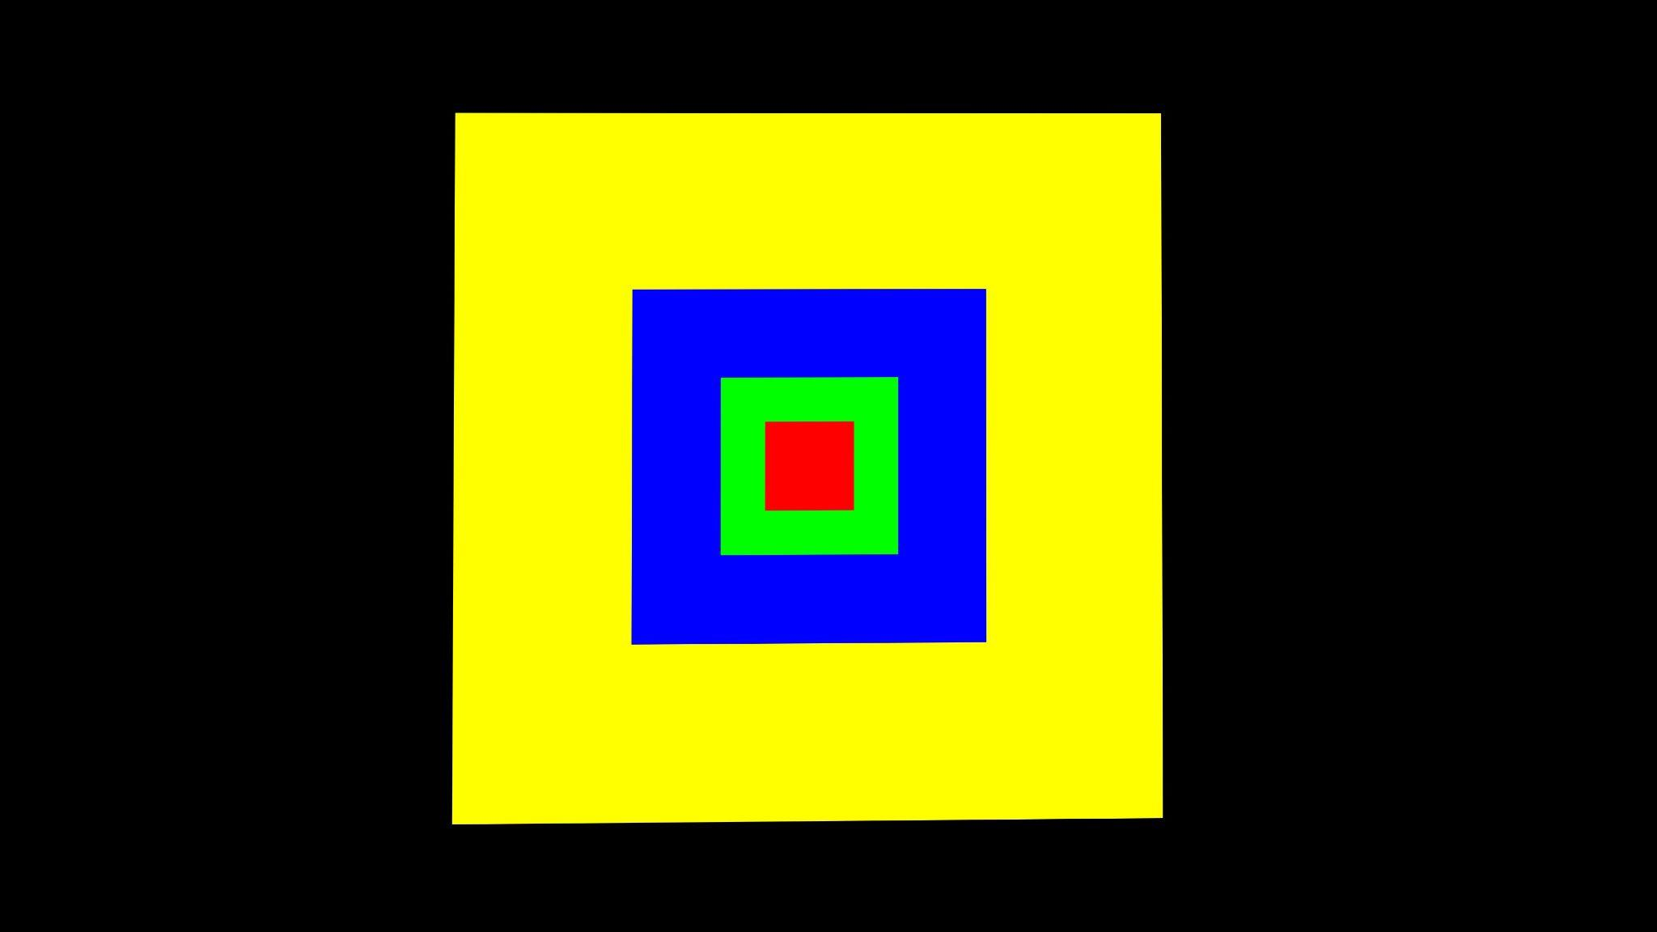
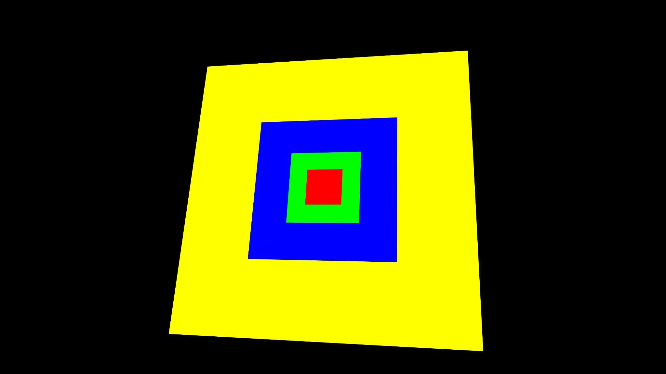
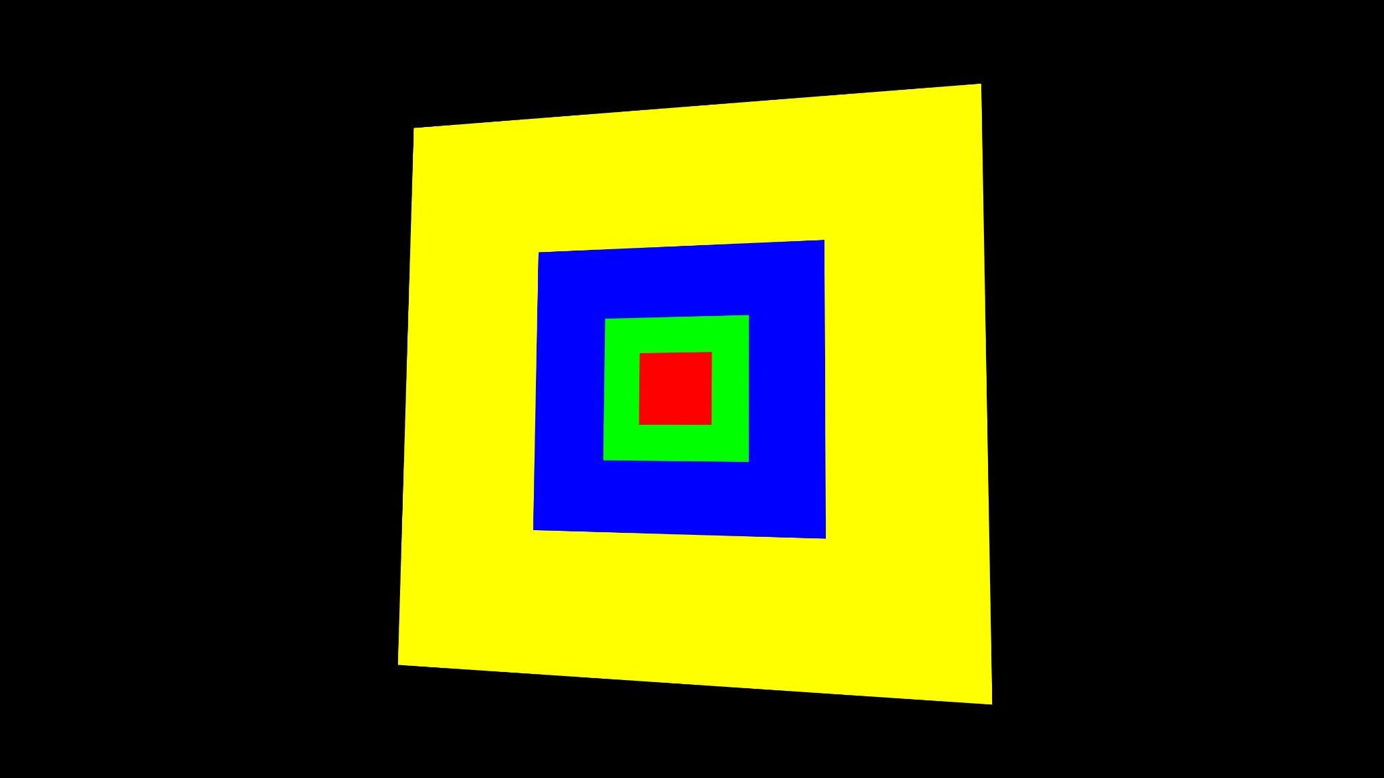
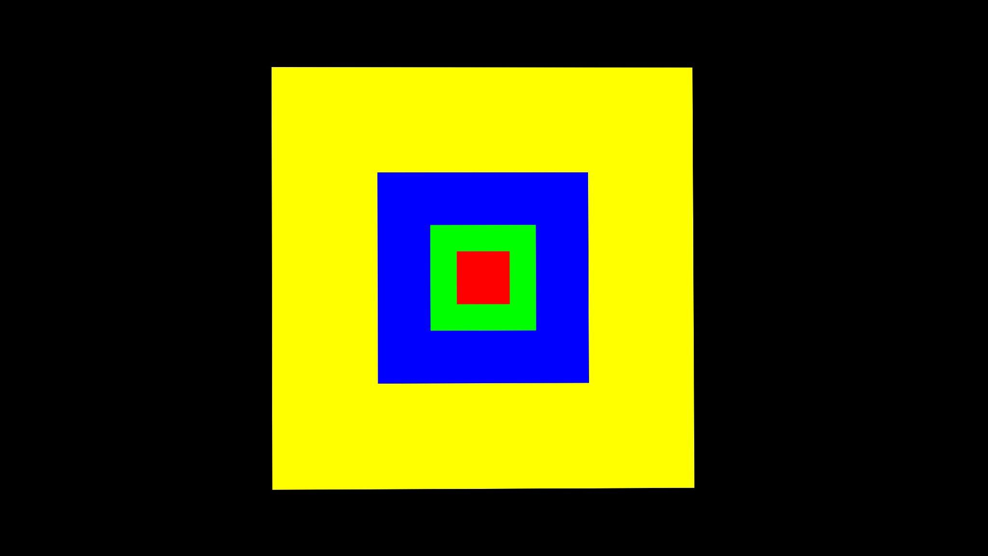
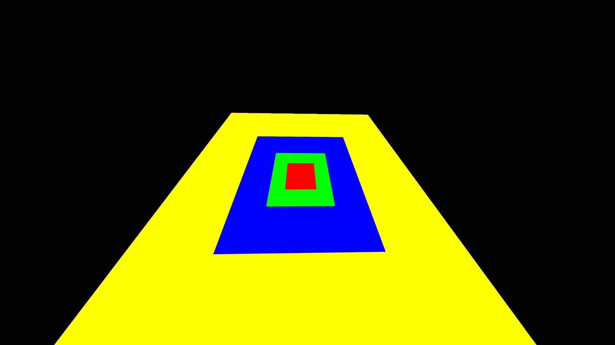
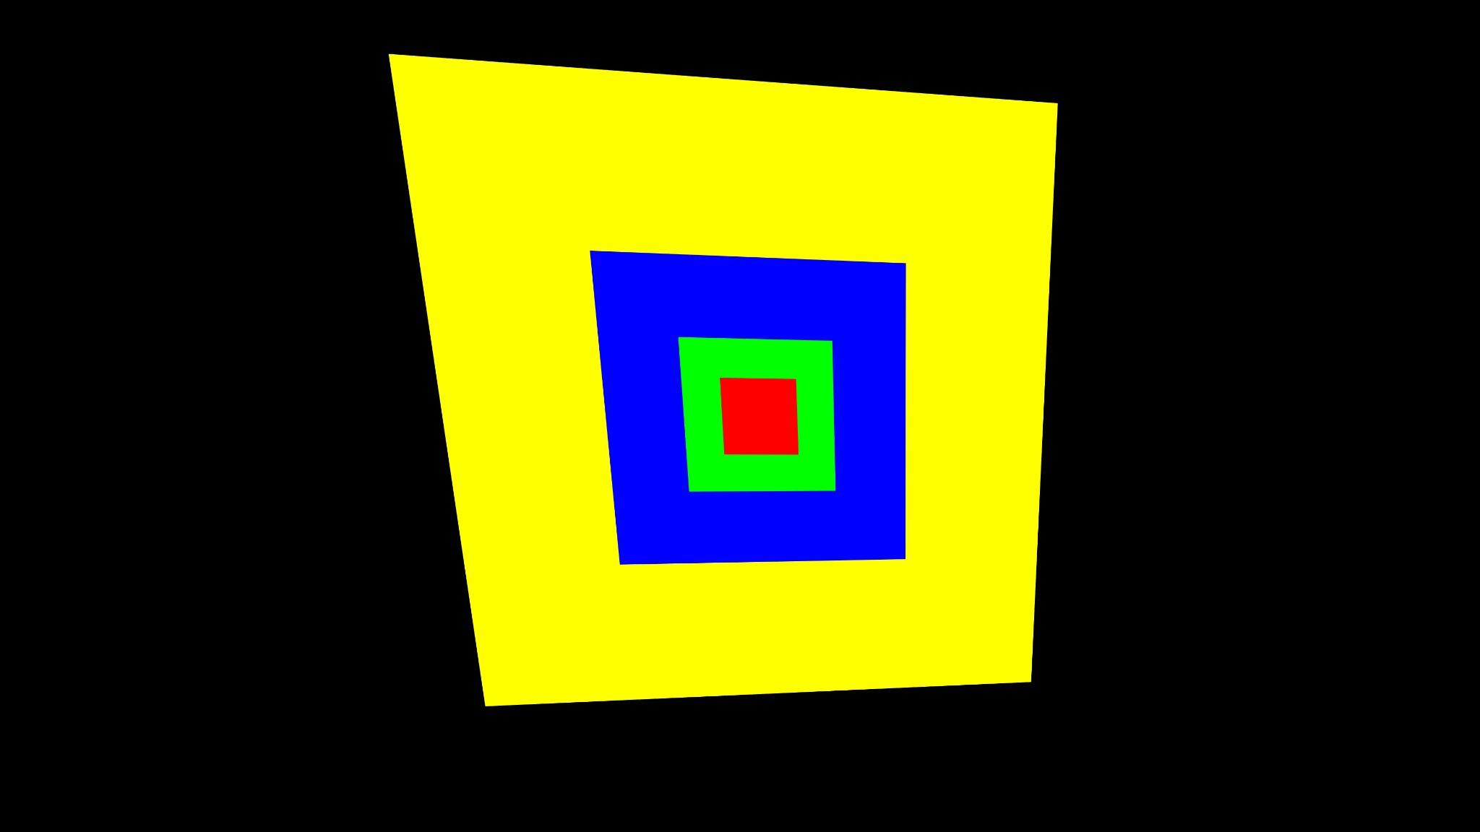
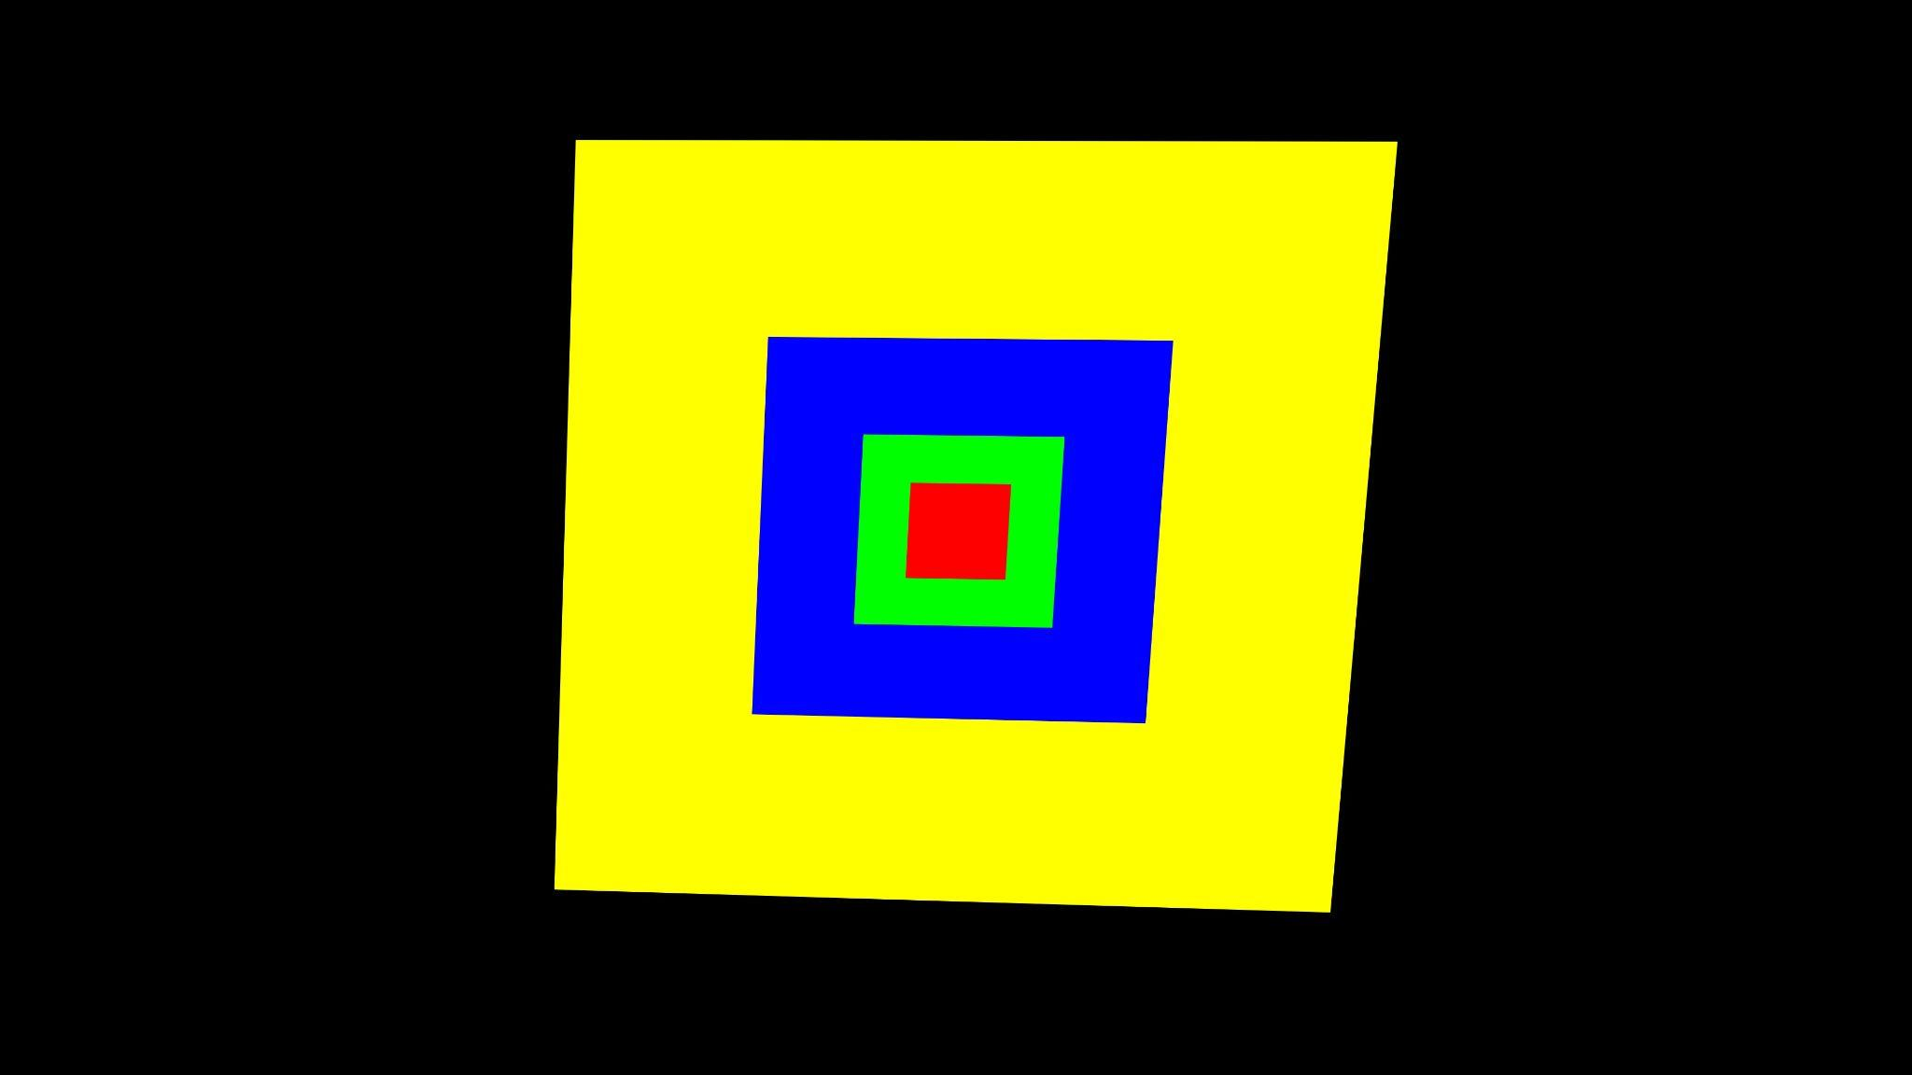
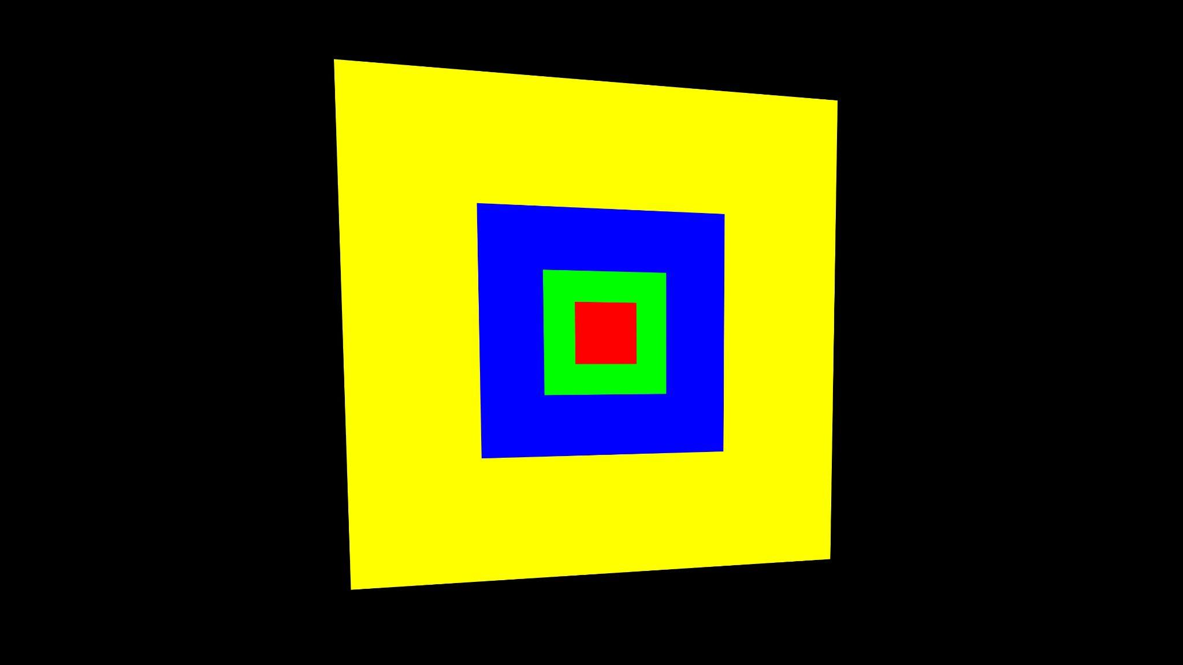
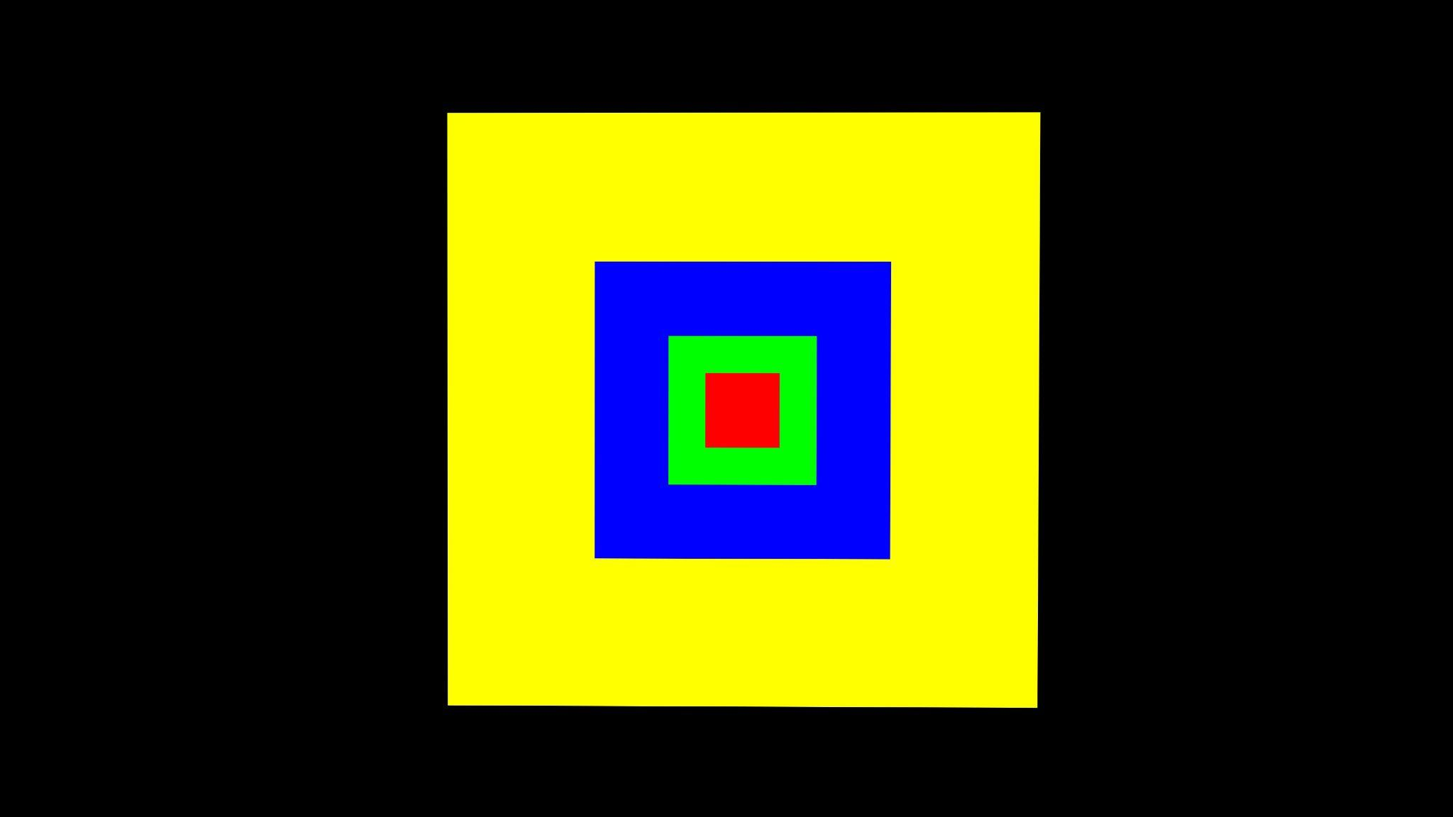
Visualization results

Slide 11
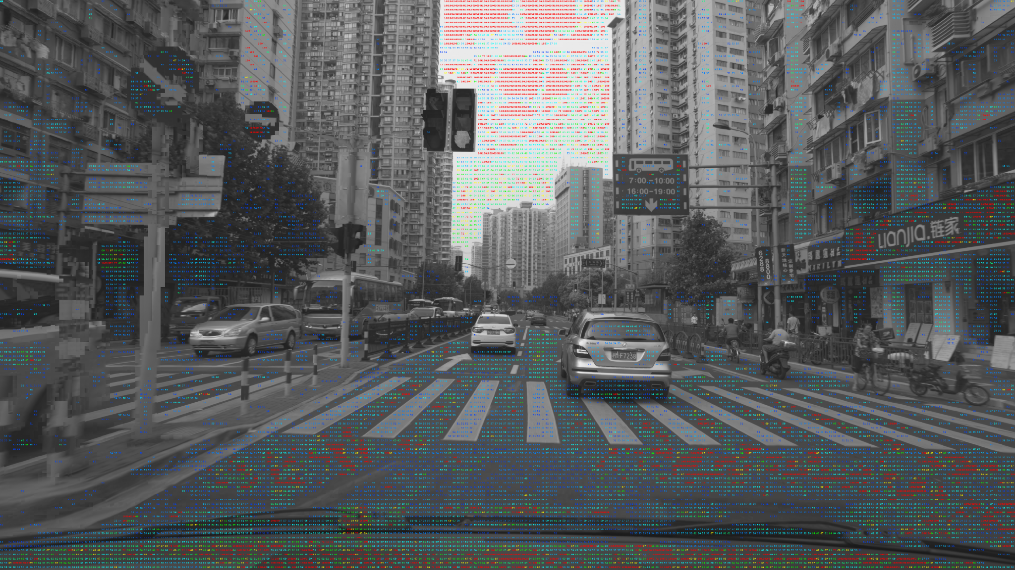
Visualization results

Slide 12
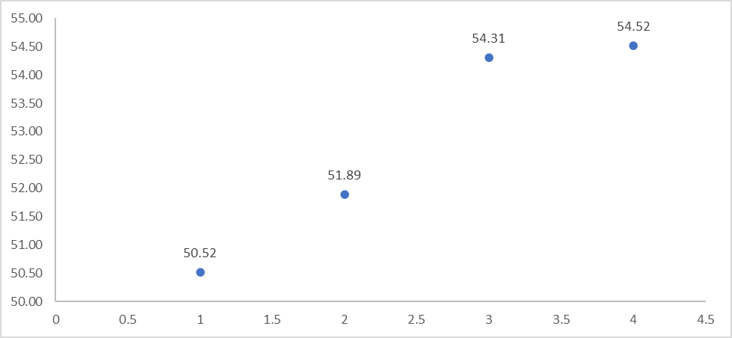
Visualization results
Add inverse
Add ref0 seg
KMeans-30
Add Greedy
KMeans-12
KMeans Base

Slide 13
Ablation study
Method | PSNR
KMeans8 | 50.38
KMeans8 + Seg | 52.61
KMeans6 | 50.57
KMeans6 + Seg | 52.84
Method | PSNR
KMeans30 | 51.89
KMeans30 + BigL | 54.31
(KMeans30 + BigL)inv | 54.52
(BigL+smallL)inv | 54.27
BigLR+smallLR | 54.40
(BigLR+smallLR)inv | 54.55

Slide 14

Conclusion
From a series of experiments, we learned the following:
Identity is a very good model.
The PSNR value highly depends on the quality of the segmentation.
The KMeans model is less effective than segmentation.
Inverse processing is sometimes useful.
The brute force method is very powerful but time-consuming

Slide 15
Thanks for your attention !

